Slide 1
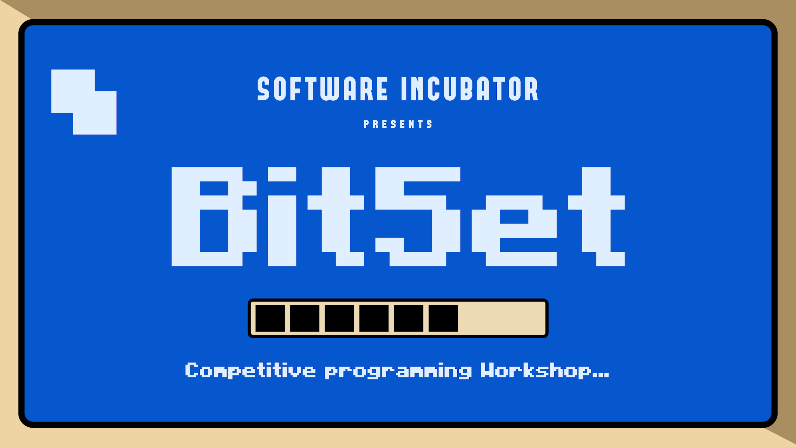

Slide 2

PRE-PROCESSORS
PRE-PROCESSORS
02

Slide 3

PRE-PROCESSORS
Pre-Processors are directives which give instruction to the compiler to preprocess information before actual compilation starts.
Eg- #include
#define
01

Slide 4
PRE-PROCESSORS
#include<filename>
The #include preprocessor directive is used to include header files in our code.
If included file is not found, compiler renders error.
Eg- #include<bits/stdc++.h>
#include<iostream.h>
02

Slide 5
PRE-PROCESSORS
#define ll long long
It is a macro.
Here we have assigned the value of long long to ll . So, whenever the name(ll) is encountered the compiler replaces the name with actual code.
Macros are defined using #define directive.
03

Slide 6
Eg-
#include<bits/stdc++.h>
#define ll long long
using namespace std;
int main()
{
ll a;
cin >> a;
cout <<a;
return 0;
}
INPUT
123456789123456789
OUTPUT
123456789123456789
04

Slide 7
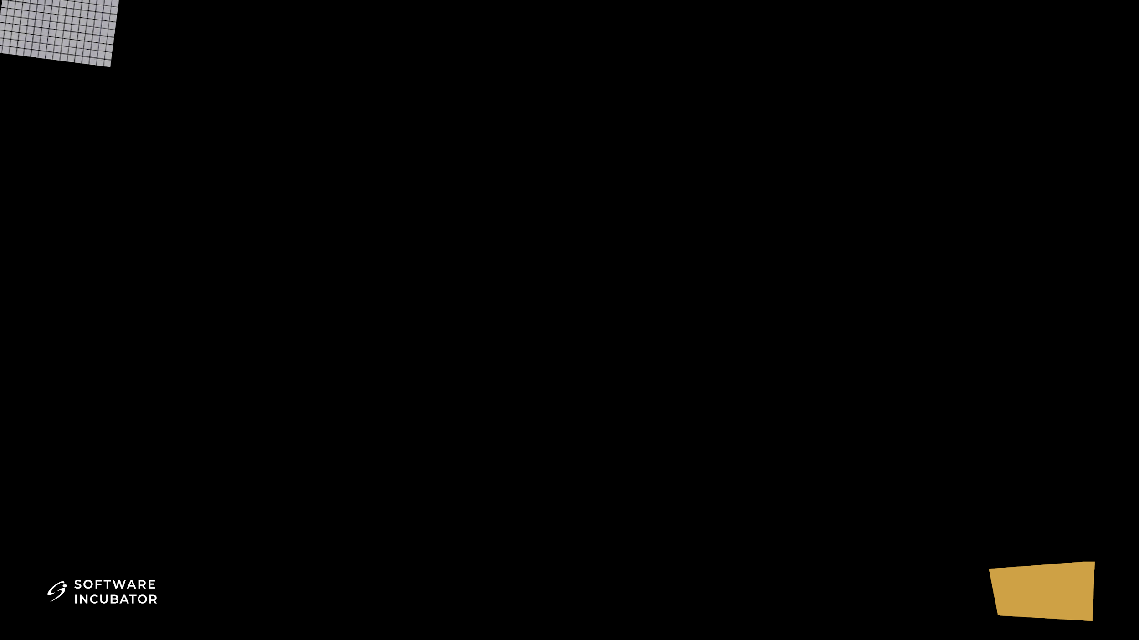
CODE ORGANISATION
CODE-ORGANISATION
07

Slide 8
This is my template which I use while coding
#include<bits/stdc++.h>
#define ll long long
using namespace std;
int main()
{
ios_base::sync_with_stdio(false);
cin.tie(NULL);
int T;
cin >> T;
while(T--) {
}
return 0;
}
05

Slide 9





VERDICT
AC - Accepted
TLE - Time Limit exceeded
WA - Wrong Answer
RE - Runtime error
CE - Compilation Error
06

Slide 10
ARRAY
ARRAY
10

Slide 11
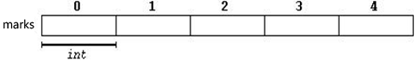
An array is a collection of elements of the same data type placed in contiguous memory locations .
For example, a five element integer array marks may be logically represented as:
Where 0,1,2.. are index of the array that are used for individual reference.
int marks[5];
marks[0] = 10
marks[1] = 50
marks[2] = 30
07

Slide 12
int a[5] = {2,4,5,6,1};
OR
int a[5]; // where 5 is size..
for(int i=0;i<5;i++)
{
cin>>a[i];
}
2
4
5
6
1
0
1
2
3
4
for(int i=0;i<5;i++)
{
cout<<a[i];
}
08

Slide 13
Chocolate Question!
int arr[5]={1,2,3,4,5};
cout<<arr;
What will be the output?
09

Slide 14

GOOD ARRAY
Q) You are given an array of integers, and your task is to determine whether it is good or not.
https://bit.ly/4j63Vrh
10

Slide 15
STRING in C++
STRING IN C++
15

Slide 16

11

Slide 17
String is basically the array of characters
#include <bits/stdc++.h>
using namespace std;
int main()
{
string str;
cin >> str; //or str=“Software”
cout << str;
return 0;
}
INPUT
Software
OUTPUT
Software
12

Slide 18
String Properties
concatenation: Two Strings can be concatenated to form another string.
Example: “Software” + “Incubator” = “SoftwareIncubator”
comparison: Two strings can be compared using the ‘==’ operator just like numbers.
Example: “SDC” == “SDC” ⇒ true
“Software” == “sdc” ⇒ false
13

Slide 19
String Functions
str_name.length(): The .length() method returns the length of a string
Example: Software = 8
substr(): substr() generates a new string with its value initialized to a copy of a sub-string of this object.
Example: “Software Incubator”.substr(0,8)
“Software”
tolower(): The tolower() function converts a given character to lowercase.
Example: tolower(‘A’) ⇒ a
14

Slide 20
String Functions
toupper(): The toupper() converts a given character to uppercase
Example: toupper(‘a’) ⇒ ‘A’
islower(): The islower() function checks if the given character is a lowercase character or not.
Example: islower(‘A’) ⇒ false
islower(‘b’) ⇒ true
isupper(): The isupper() function in C++ checks if the given character is a uppercase character or not.
Example: isupper(‘A’) ⇒ true
isupper(‘b’) ⇒ false
15

Slide 21
Consonant Shift
Q)Given a string s, replace every consonant with the next letter in the alphabets while keeping vowels unchanged.
https://bit.ly/4lpggIG
16

Slide 22
Functions
FUNCTIONS
22

Slide 23
int main() {
int arr_1[5] = {1, 2, 3, 4, 5};
for (int i=0; i<5; i++){
cout << arr_1[i] << “ “;
}
.
.
.
int arr_n[5] = {6, 7, 8, 9, 10};
for (int i=0; i<5; i++){
cout << arr_n[i] << “ “;
}
return 0;
}
OUTPUT
1 2 3 4 5
.
.
.
6 7 8 9 10
17

Slide 24
Syntax of functions
return_type function_name(data_type parameter1, data_type parameter2, …) {
// code
return statement
}
# function to add two numbers
int add(int a, int b){
return a+b;
}
18
Notes:
Add a slide with manual sum 7-8 times

Slide 25
#include<bits/stdc++.h> // program to print arrays
using namespace std;
void print_array(int arr[], int n){ // function definition
for (int i=0; i<n; i++){
cout<<arr[i]<<endl;
}
}
int main() {
int arr[5] = {1, 2, 3, 4, 5};
int arr[5] = {6, 7, 8, 9, 10};
return 0;
}
19

Slide 26
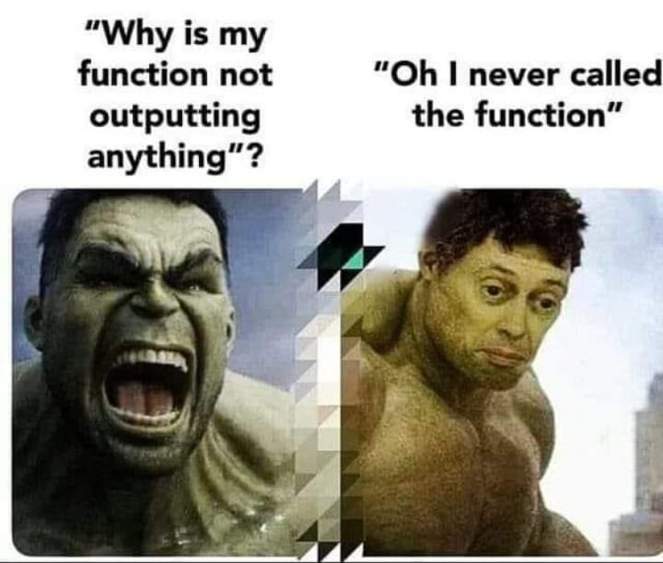
20

Slide 27
#include<bits/stdc++.h> // program to print arrays
using namespace std;
void print_array(int arr[], int n){ // function definition
for (int i=0; i<n; i++){
cout<<arr[i]<<” “;
}
cout << endl;
}
int main() {
int arr1[5] = {1, 2, 3, 4, 5};
print_array(arr1,5); // function call
int arr2[5] = {6, 7, 8, 9, 10};
print_array(arr2,5); // function call
return 0;
}
OUTPUT
1 2 3 4 5
6 7 8 9 10
21

Slide 28
Why do we need functions?
Reduction in Program Size
Reducing Complexity of Program
Easy to Debug and Maintain
Readability of Program
Code Reusability
22

Slide 29
Absolute Differences
Q) Write a program to find the absolute difference of the sum of elements of two different arrays.
23

Slide 30
int main() {
int n, m;
cin>>n>>m;
int arr1[n], arr2[m];
for(int i=0; i<n; i++)
cin>>arr1[i];
for(int i=0; i<m; i++)
cin>>arr2[i];
int sum1 = sum(arr1, n);
int sum2 = sum(arr2, m);
cout<<abs(sum1-sum2)<<"\n";
return 0;
}
Solution
#include <bits/stdc++.h>
using namespace std;
int sum(int arr[], int n){
int ans = 0;
for(int i=0;i<n;i++)
ans += arr[i];
return ans;
}
24

Slide 31
Chocolate Question
void doubleIt(int arr[], int s, int n){
n *= 2;
for(int i=0;i<s;i++)
arr[i] *= 2;
}
int main(){
int n =10;
int arr[]={1,2,3,4,5};
doubleIt(arr,5,n);
cout<<n<<endl;
print_array(arr,5);
return 0;
}
OUTPUT
10
2 4 6 8 10
25

Slide 32
Call by value VS Call by reference
Call By Value: Call by value is a parameter passing mechanism where a copy of the argument is passed to the function, so changes to the parameter inside the function do not affect the original argument.
void solve(int n)
Call By Reference: Call by reference means passing the address of the variable to a function, so any changes made inside the function affect the original variable.
void solve(int &n)
26

Slide 33
Solution
void doubleIt(int arr[], int s, int &n){
n *= 2;
for(int i=0;i<s;i++)
arr[i] *= 2;
}
int main(){
int n =10;
int arr[]={1,2,3,4,5};
doubleIt(arr,5,n);
cout<<n<<endl;
print_array(arr,5);
return 0;
}
OUTPUT
20
2 4 6 8 10
27

Slide 34
Built-in functions
1. max(a,b) - returns max of two numbers
2. min(a,b) - returns min of two numbers
3. swap(a,b) - swap the number
4. abs(a) - equivalent to modulus of a number in maths
5. pow(a,b) - returns a to the power b
6. floor(a) - equivalent to floor function in maths; floor(2.5) = 2
7. ceil(a) - equivalent to ceil function in maths; ceil(2.5) = 3
8. round(a) - rounds the number to the nearest integer
9. sqrt(a) - return the square root of the number
28

Slide 35

TIME COMPLEXITY
TIME COMPLEXITY
35

Slide 36
PROBLEM STATEMENT
Q.) Write a program to find the sum of first n natural number.
(n is a positive integer).
29

Slide 37
Approach 1
void solve(int n){
long long sum = 0;
for(int a=1;a<=n;a++){
sum += a;
}
cout<<sum<<endl;
return ;
}
30

Slide 38
Approach 2
void solve(int n){
long long sum=n*(n+1)/2;
cout<<sum<<endl;
return ;
}
31

Slide 39
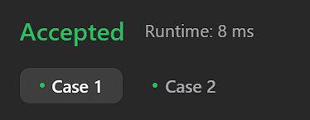
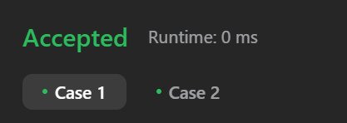
Approach 1
void solve(int n){
long long sum = 0;
for(int a=1;a<=n;a++){
sum += a;
}
cout<<sum<<endl;
}
Approach 2
void solve(int n){
long long sum=n*(n+1)/2;
cout<<sum<<endl;
return ;
}
32

Slide 40
How can we compare two algorithms?
No. of lines?
Execution time?
No. of operations?
33

Slide 41
EXAMPLES
cin>>x; cout<<x; --------- c unit of time.=> constant
for(int i=1;i<=10;i++) --- 10c units of time.=> constant
for(int i=1;i<=n;i++) --- n units of time. => not constant
4. for (int i = 1; i <= n; i++) {
for (int j = 1; j <= n; j++) {
cout<<”SI ”;
}
}
When i=1, it will run n times.
When i=2, it will run n times.
When i=3, it will run n times and so on.
The total number of times “SI” will run is n+n+n+...+n = n*n. So, the time complexity will be n^2 units of time.
34

Slide 42
4. for (int i = 1; i <= n; i++) { for (int j = 1; j <= i; j++) { cout<<”SI ”;
}
}
Let us see how many times “SI” will be printed.
When i=1, it will run 1 time.
When i=2, it will run 2 times.
When i=3, it will run 3 times and so on.
The total number of times “SI” will run is 1+2+...+(n−1)+n=n∗(n+1)/2=n²/2+ n/2.
35

Slide 43
The time complexity is the computational complexity that describes the amount of time it takes to run an algorithm.
Since there are many ways to solve a problem but we always try to find the most efficient solution i.e the one which takes minimum amount of time.
36

Slide 44
Patterns for Time Complexity
1. long long a = 1000000000;
long long b = 1000000000;
cout<<a + b<<endl;
Time complexity - O(1)Time
2. for (int i = 1; i <= n; i++) { cout<<”SI”;
}
Time complexity - O(n)Time
3. for (int i = 0; i <= n; i++) {
for (int j = 0; j <= m;j++) cout<<”SI”;
}
Time complexity - O(n * m)
37

Slide 45
4. for (int i = 1; i <= n; i*=2) { cout<<”SI ”;
}
Time complexity - O(logn)
Time complexity - O(log n)
5. for(int i = n; i >= 1; i/=2) { cout<<”SI ”;
}
38

Slide 46
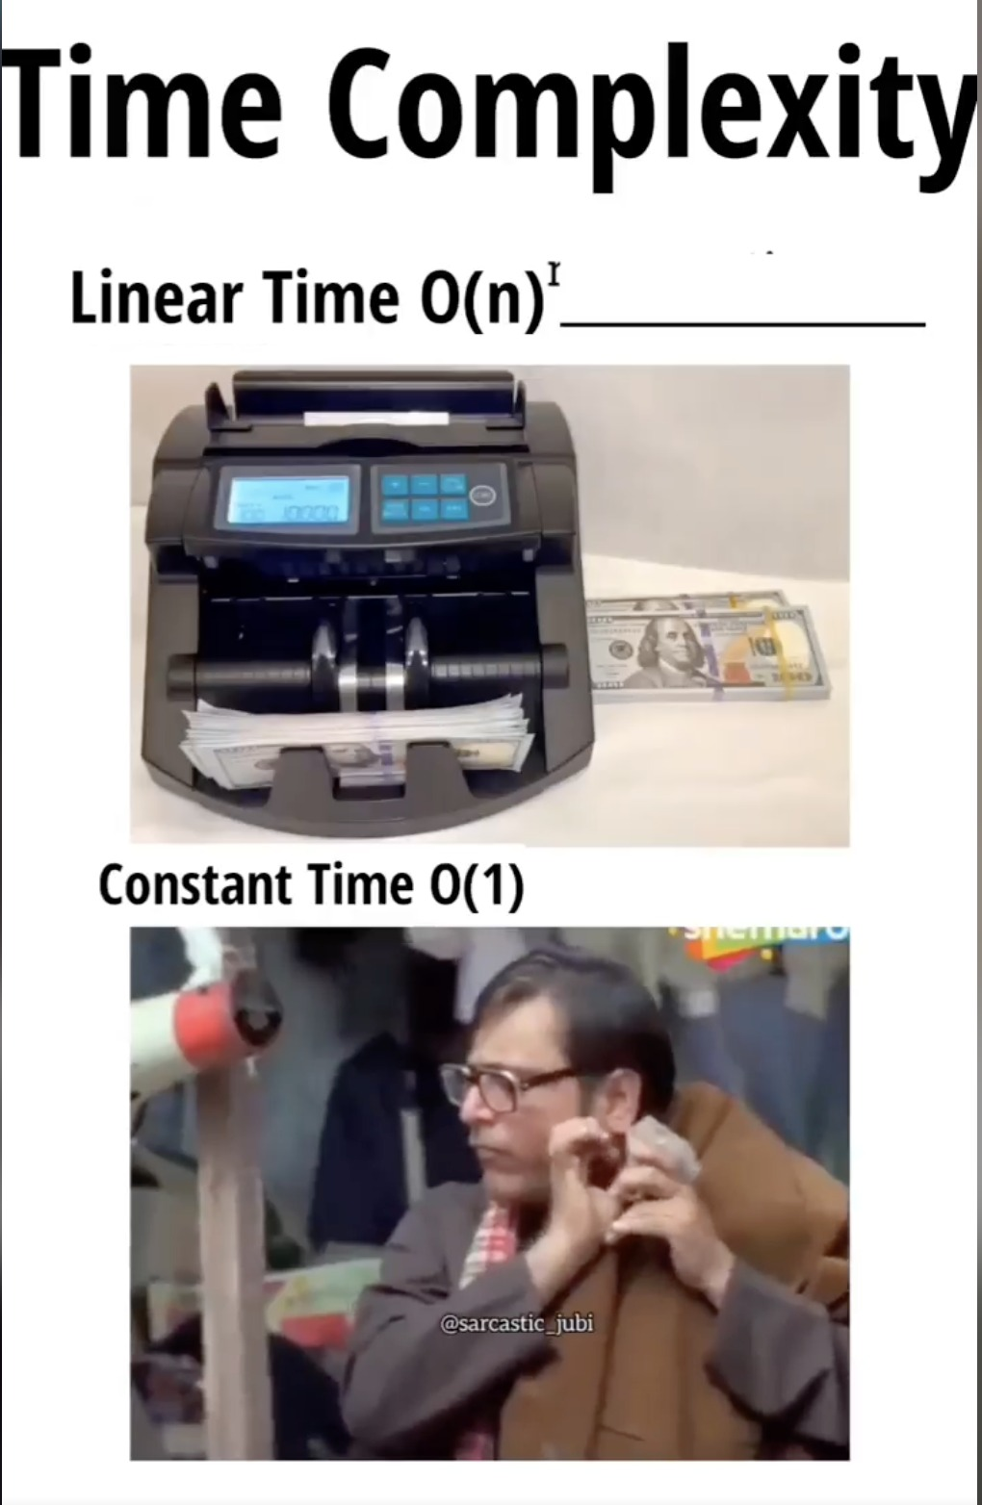
39

Slide 47
Find the time complexity for the given code snippet
int n;
cin >> n;
for(int i=1; i<=n; i++){
for(int j=1; j<=n; j++){
cout << "SI"<< " ";
}
}
for(int i=1; i<=n; i++){
cout << "SI"<< " ";
}
cout << "SI"<< " ";
TIME COMPLEXITY:
O(n^2+n)
40

Slide 48
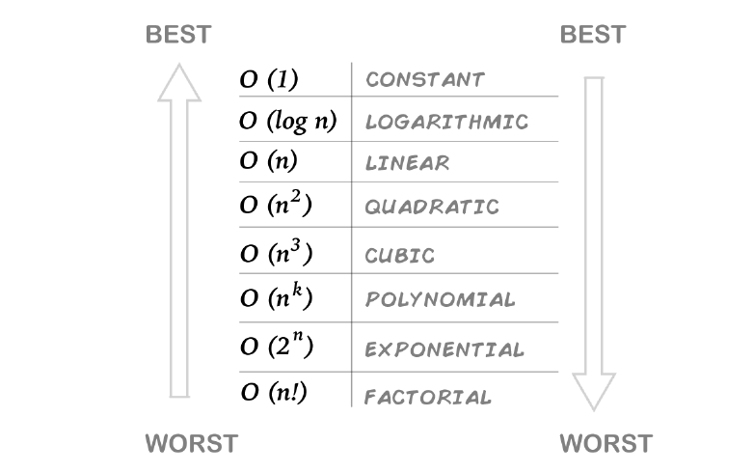
41

Slide 49
Q) How many computations a computer can do in 1 second?
Ans. 10⁸ approx. computations.
42

Slide 50
SPACE COMPLEXITY
Prefix Sum
50

Slide 51
Total Earnings
Q) You are given an array of integers representing the daily earnings of a shop over several days. Each query consists of two integers, l and r, representing a range of days.
https://bit.ly/428yMO4
43

Slide 52
Analysis on the basis of constraint
We must follow up on our approach by analysing the constraint of the problem.
For eg -
Constraint -
1 <= N <= 10⁵
1 <= Q <= 10⁵
1 <= L, R <= N
For this it is clear that we cannot run a for loop from 1 to n i.e. our algorithm must have time complexity less than O(n).
44

Slide 53
0
1
2
3
4
Given Array:
2 | 5 | 1 | 4 | 6
1
2
3
4
5
Q: L = 1 , R = 4
Ans: 16
Here we are considering that number of queries, Q=1
45

Slide 54
What if we have multiple range queries on the same array?
0
1
2
3
4
4
Given Array:
2 | 5 | 1 | 4 | 6
Q1 : L = 1 , R = 4
Q2 : L = 0 , R = 2
Q3 : L = 2 , R = 4
46

Slide 55

47

Slide 56
0
1
2
3
4
Given Array:
a | b | c | d | e
0
1
2
3
4
Prefix Array:
a | a + b | a + b + c | a + b + c + d | a + b + c + d + e
Q1 : L = 1 , R = 4
Q2 : L = 0 , R = 2
Q3 : L = 2 , R = 4
Ans.1 b + c + d + e
= P[4] - P[0]
Ans.2 a + b + c
= P[2]
Ans.3 c + d + e
= P[4] - P[1]
48

Slide 57
0
1
2
3
4
Given Array:
2 | 5 | 1 | 4 | 6
0
1
2
3
4
Prefix Array:
2 | 7 | 8 | 12 | 18
Q1 : L = 1 , R = 4
Q2 : L = 0 , R = 2
Q3 : L = 2 , R = 4
Ans.1 P[4] - P[0] = 18 - 2 = 16
Ans.2 P[2] = 8
Ans.3 P[4] - P[1] = 18 - 7 = 11
49

Slide 58

50

Slide 59
C
COUNT FACTORS OF A NUMBER
60

Slide 60
FACTORS OF 30=1,2,3,5,6,10,15,30

Slide 61
Approach 1 (Brute Force)
#include <bits/stdc++.h>
using namespace std;
#define ll long long
int main() {
ll n;
cin >> n;
int count = 0;
for(int i = 1; i <= n; ++i) {
if((n % i)== 0)
count++;
}
cout << count<<’\n’;
return 0;
}
Time : 1 sec
n < 10⁸
51

Slide 62
Prime Factor Count
Constraints
Q. Given an integer N, how many distinct prime factors this number has.
1 <= T <= 100
1 <= N <= 10¹²
https://bit.ly/4ls0Rax
52

Slide 63
Approach 2 (Optimal Approach)
#include <bits/stdc++.h>
using namespace std;
#define int long long
signed main(){
int n;
cin>>n;
int ans = 0;
for(int i=1;i*i<=n;i++){
if(n % i == 0){
if(i != n / i) ans += 2;
else ans++;
}
}
cout<<ans<<"\n";
}
53

Slide 64
Count Factors of a number
Approach 3
If we run loop upto sqrt(n) terms.
In constraint of 10¹² we have to run loop = sqrt(10¹²) = 10⁶ times
54

Slide 65
We know that factors exist in pairs.
For n=30,
1 * 30
2 * 15
3 * 10
5 * 6
6 * 5
10 * 3
15 * 2
30 * 1
55

Slide 66

1 * 30
2 * 15
3 * 10
5 * 6
30 * 1
15 * 2
10 * 3
6 * 5
56

Slide 67
We notice that the factors start repeating after the point sqrt(n).
Thus, we run our loop from 1 to sqrt(n) and add 2 in our answer if both the numbers in the pair of factors are different else we add 1.
57

Slide 68
Another way to visualise sqrt(n)
Factors always exist in pairs.
Let’s assume that we have two factors x and y of a number n.
So, n= x * y
Also, n= √n * √n
x * y= √n * √n
58

Slide 69
CASE 1:
If x < √n then y > √n
CASE 2:
If x > √n then y < √n
CASE 3:
If x == √n then y== √n
This implies that there will always be a factor (either x or y) which will be less than or equal to √n
59

Slide 70
PRIME NUMBERS

Slide 71
Prime Numbers
The numbers having only two factors 1 and the number itself are known as prime numbers and the numbers which are not prime are known as composite numbers.
Eg - 2, 3, 5, 7, 11, etc.
1 is neither prime nor composite
60

Slide 72
Code
#include <bits/stdc++.h>
using namespace std;
#define int long long
signed main(){
int n;
cin>>n; bool f = 1;
if(n == 1) f = 0;
for(int i=2;i*i<=n;i++){
if(n % i == 0){
f = 0;
break;
}
}
if(f == 1) cout<<”Prime Number\n”;
else cout<<”Not a prime number\n”;
}
61

Slide 73
SIEVE OF ERATOSTHENES

Slide 74

62

Slide 75
Sieve Of Eratosthenes
Let n=29
Step 1: Create an integer array of size 30 i.e sieve[30].
Indicies are from 0 to 29.
0 | 1 | 2 | 3 | 4 | 5
6 | 7 | 8 | 9 | 10 | 11
12 | 13 | 14 | 15 | 16 | 17
18 | 19 | 20 | 21 | 22 | 23
24 | 25 | 26 | 27 | 28 | 29
63

Slide 76
Sieve Of Eratosthenes
Step 2: Initialize the complete array with 1.
0 and 1 are neither prime nor composite so store 0 at these indices.
0 0 | 0 1 | 1 2 | 1 3 | 1 4 | 1 5
1 6 | 1 7 | 1 8 | 1 9 | 1 10 | 1 11
1 12 | 1 13 | 1 14 | 1 15 | 1 16 | 1 17
1 18 | 1 19 | 1 20 | 1 21 | 1 22 | 1 23
1 24 | 1 25 | 1 26 | 1 27 | 1 28 | 1 29
64

Slide 77
Sieve Of Eratosthenes
Step 3: All multiples of 2 will be non-prime.
0 0 | 0 1 | 1 2 | 1 3 | 0 4 | 1 5
0 6 | 1 7 | 0 8 | 1 9 | 0 10 | 1 11
0 12 | 1 13 | 0 14 | 1 15 | 0 16 | 1 17
0 18 | 1 19 | 0 20 | 1 21 | 0 22 | 1 23
0 24 | 1 25 | 0 26 | 1 27 | 0 28 | 1 29
65

Slide 78
Sieve Of Eratosthenes
Step 4: All multiples of two 3 will be non-prime.
0 0 | 0 1 | 1 2 | 1 3 | 0 4 | 1 5
0 6 | 1 7 | 0 8 | 0 9 | 0 10 | 1 11
0 12 | 1 13 | 0 14 | 0 15 | 0 16 | 1 17
0 18 | 1 19 | 0 20 | 0 21 | 0 22 | 1 23
0 24 | 1 25 | 0 26 | 0 27 | 0 28 | 1 29
66

Slide 79
Sieve Of Eratosthenes
Step 5:Since 4 is itself non-prime so we need not to do anything.
0 0 | 0 1 | 1 2 | 1 3 | 0 4 | 1 5
0 6 | 1 7 | 0 8 | 0 9 | 0 10 | 1 11
0 12 | 1 13 | 0 14 | 0 15 | 0 16 | 1 17
0 18 | 1 19 | 0 20 | 0 21 | 0 22 | 1 23
0 24 | 1 25 | 0 26 | 0 27 | 0 28 | 1 29
67

Slide 80
Sieve Of Eratosthenes
Step 6: All multiples of 5 will be non-prime.
0 0 | 0 1 | 1 2 | 1 3 | 0 4 | 1 5
0 6 | 1 7 | 0 8 | 0 9 | 0 10 | 1 11
0 12 | 1 13 | 0 14 | 0 15 | 0 16 | 1 17
0 18 | 1 19 | 0 20 | 0 21 | 0 22 | 1 23
0 24 | 0 25 | 0 26 | 0 27 | 0 28 | 1 29
68

Slide 81
int main() {
int n;
cin>>n;
int sieve[n+1];
for(int i=0;i<=n;i++) sieve[i]=1;
sieve[0]=sieve[1]=0;
for(int i=2;i<=n;i++) {
if(sieve[i]==1) {
for(int j=i*i;j<=n;j+=i)
sieve[j]=0;
}
}
return 0;
}
Now all prime numbers will have 1 in the respective index of the array.
69

Slide 82
Sieve Of Eratosthenes
The sieve of Eratosthenes is one of the most efficient ways to find all primes smaller than n when n is smaller than 1000000.
Time Complexity = O( n * log(log(n)))
Refer the link to learn more about sieve of eratosthenes:-
https://www.geeksforgeeks.org/sieve-of-eratosthenes/
70

Slide 83
Modular Arithmetic
When we divide two integers we will have an equation that looks like the following:
A/B = Q remainder R
A is the dividend B is the divisor
Q is the quotient R is the remainder
Sometimes, we are only interested in what the remainder is when we divide A by B
71

Slide 84
Remainder Theorem
Given, A/B:
A -> Dividend B -> Divisor
Q -> Quotient R -> Remainder
Dividend = (Divisor × Quotient) + Remainder
A = (B × Q) + R
72

Slide 85
Count Even Odd Digits
Q) Count the number of even and odd digits in the number 'n'.
http://bit.ly/4cyQNsq
73

Slide 86
a%b can be written as a-(a/b)*b .
Eg -> a = 7, b = 3, then
a%b = 7 - (7/3)*3
= 7 -(2) * 3
= 7 - 6 = 1
74

Slide 87
Cyclic Property of modulo
0%5=0 5%5=0
1%5=1 6%5=1
2%5=2 7%5=2
3%5=3 8%5=3
4%5=4 9%5=4
a%m=(a+m) % m = (a%m + m%m)
= a%m + 0 = a%m
75

Slide 88

76

Slide 89
Negative Modulo
-1%5=4 -6%5=4
-2%5=3 -7%5=3
-3%5=2 -8%5=2
-4%5=1 -9%5=1
-5%5=0 -10%5=0
a%m = (a%m + m) % m
77

Slide 90
Properties of modulo
(a + b) % m = (a%m + b%m)%m
(a - b) % m = (a%m - b%m + m)%m
(a * b) % m = (a%m * b%m)%m
(a / b)%m = ????
78

Slide 91
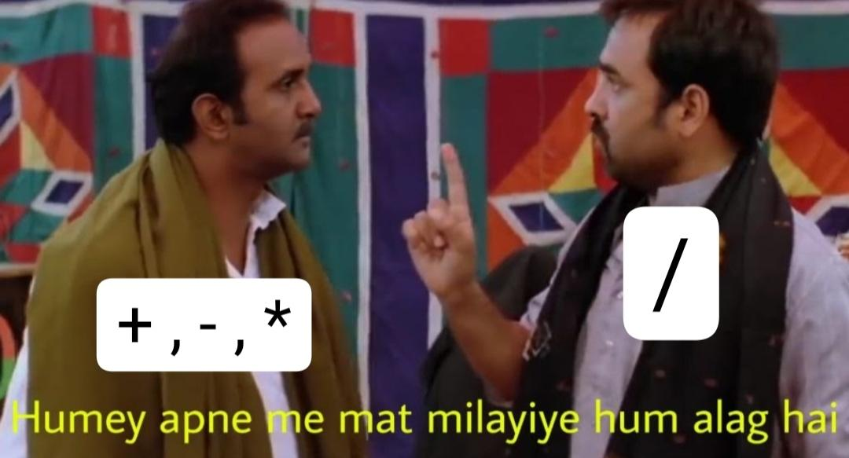
79

Slide 92
BIG FACTORIAL
Q.) Find the Factorial of a number .
Constraint : 0 <= N <= 10^5
80

Slide 93


Feedback Form
bit.ly/4j9PxhX
81

